Slide 1
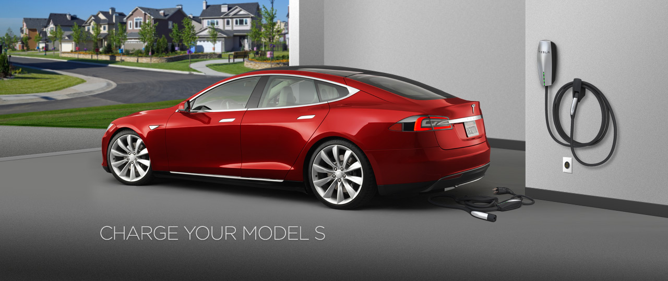
Smart Microgrid with Electric Vehicles
Modelling and Simulating
Social Systems with MATLAB
14 December 2015
XINGLIANG FANG
SEOHO JUNG
HUITING ZHANG

Slide 2
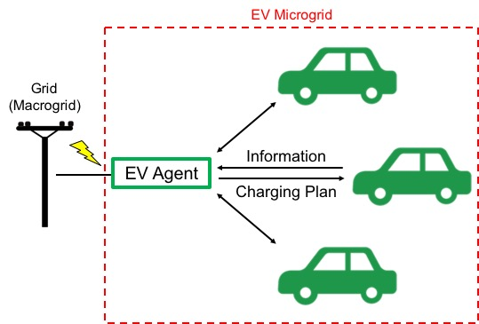
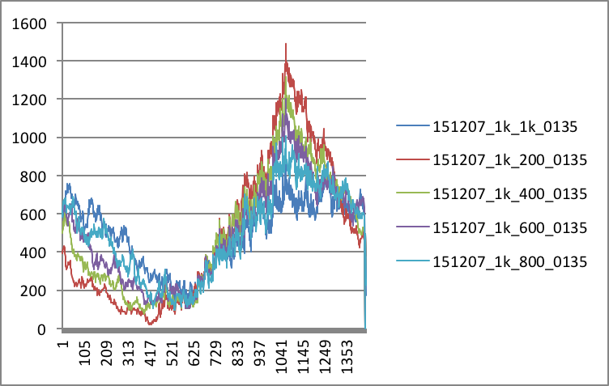

PRESENTATION OVERVIEW
1. Model
3. Results and Discussion
2. Implementation
Improved Grid Robustness
Reduced Cost
- Driving Profile
- SOC
- Power
- Cost

Slide 3
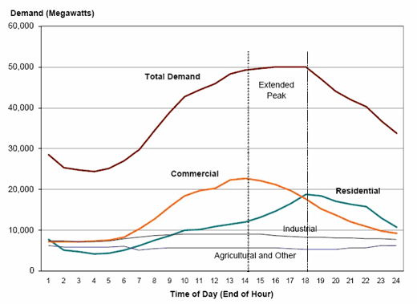
INTRODUCTION
Expected to increase due to EV Charging
Solutions
Increasing generation
-> Underutilization of Facilities
Managing demand effectively
Notes:
Power consumption during evening hours is expected to be high, while that is early morning between 2 AM and 6 AM is low because all vehicles are already fully charged.

Slide 4
MODEL
EV Agent Model
Every EV receives a charging plan from EV agent
Our interests
: alleviating peak load by shifting power consumption of some EVs (improving grid robustness)
: reducing cost of charging
Assumptions
EVs only charge at home
All vehicles are Tesla Model S (2015 85D)
Our analysis is based on electricity pricing and driving profile in Texas

Slide 5
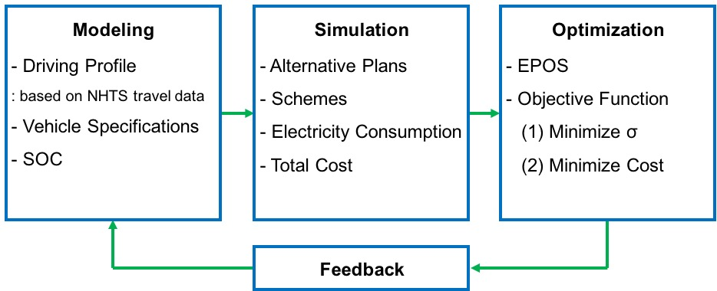
IMPLEMENTATION

Slide 6
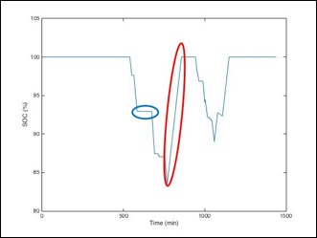
IMPLEMENTATION

Slide 7
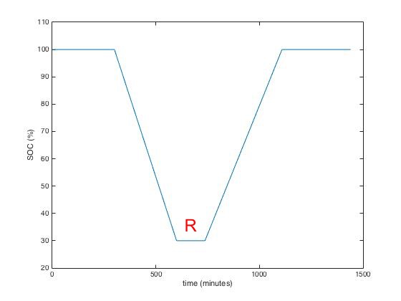
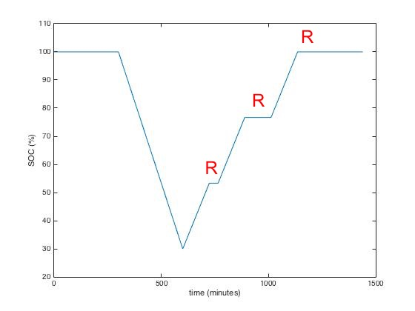
ALTERNATIVE PLANS
 | Start | Number of Steps
Original Plan | Immediate | 1
Alternative Plan 1 | Random | 1
Alternative Plan 2 | Immediate | 2
Alternative Plan 3 | Random | 2
Alternative Plan 4 | Immediate | 3
Alternative Plan 5 | Random | 3

Slide 8
RESULTS AND DISCUSSION- Preliminary Experiment
Original
Peak - Valley
-> Robustness of the grid
Off/ Peak Pricing
-> Cost for the customers
Diurnal Driving

Slide 9
RESULTS AND DISCUSSION- Preliminary Experiment
Results
Optimization for Robustness
SCHEME 1(0,1,1,1): good AP1
-> SCHEME 2(0,2,2,2), 4(0,4,4,4):
Random starting for AP 2 and 4 needed
-> Optimization for cost
Plan | Start | Steps
0 | Immediate | 1
1 | Random | 1
2 | Immediate | 2
4 | Immediate | 3

Slide 10
REFERENCES
[1] Image on Page 1: https://www.teslamotors.com/model-charging
[2] R. E. Brown, J. G. Koomey, Electricity Use in California: Past Trends and Present Usage Patterns (2002)
[3]

